Slide 1

Stock price prediction of Apple Inc. using ARIMA
Tishika vasudev
Bsc. Data Science

Slide 2

Apple Inc.
Founded: 1976
Industry: Technology
Headquarters: California, USA
Products:
- iPhone
-MacBook
- iPad
- Apple Watch

Slide 3
Problem Statement
Stock Prices
change daily
Inventors
need forecasting techniques to make better decisions.

Slide 4

Analyze historical stock prices
Objectives :
Forecast future prices
Evaluate model performance

Slide 5




# 1
source: GitHub Financial Dataset
Dataset Description
# 2
target variable: AAPL.Close

Slide 6
ARIMA Model
Auto Regressive
Integrated
stands for:
Moving Average
Model used: ARIMA(5,1,0)

Slide 7

Methodology:
Load Dataset
Select Closing Price
Train-Test Split
Apply ARIMA
Forecast Future Values
Evaluate using RMSE

Slide 8

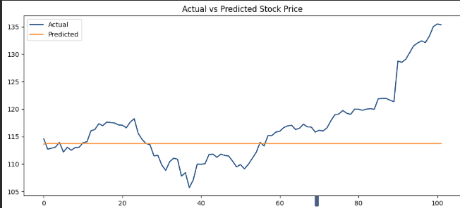
Result:
RMSE Value:
7.3263296374327

Slide 9


Advantages:
Easy to implement
Good for short-term forecasting
Limitations:
Cannot predict sudden market crashes
Uses only historical prices
Advantages & Limitations

Slide 10
ARIMA successfully forecasted Apple stock prices using historical data.
Conclusion:
The model can help investors understand future market trends.

